Slide 1

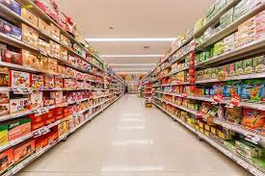

ATLIQ MART
Codebasics Resume Challenge
Presented by Rutuja Thorve

Slide 2
Content :
About Business
Problem statement
Data model
Dashboard
Insights
recommendations
1
2
3
4
5
6

Slide 3
AtliQ Mart
AtliQ Mart is a growing FMCG manufacturaer headquartered in Gujarat, India.
Branches
Surat
Ahmedabad
Vadodara

Slide 4
Product categories
Dairy
Food
Baverages
AM Milk 500
AM Biscuits 750
AM Tea 500
AM Milk 250
AM Biscuits 500
AM Tea 250
AM Milk 100
AM Biscuits 250
AM Tea 100
AM Butter 500
AM Butter 250
AM Butter 100
AM Ghee 250
AM Ghee 150
AM Ghee 100
AM Curd 250
AM Curd 100
AM Curd 50

Slide 5
Problem Statement
AtliQ Mart is currently facing problems where a few key customers did not extend their annual contracts due to service issues.
Thus management wants to fix this issue before expanding to other cities by tracking the ‘On Time’ and ‘In Full’ delivery service level for all the customers.

Slide 6
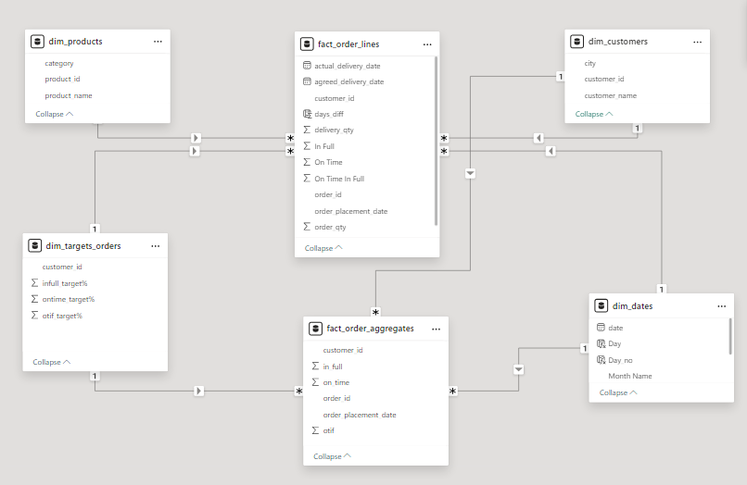
Data Model

Slide 7
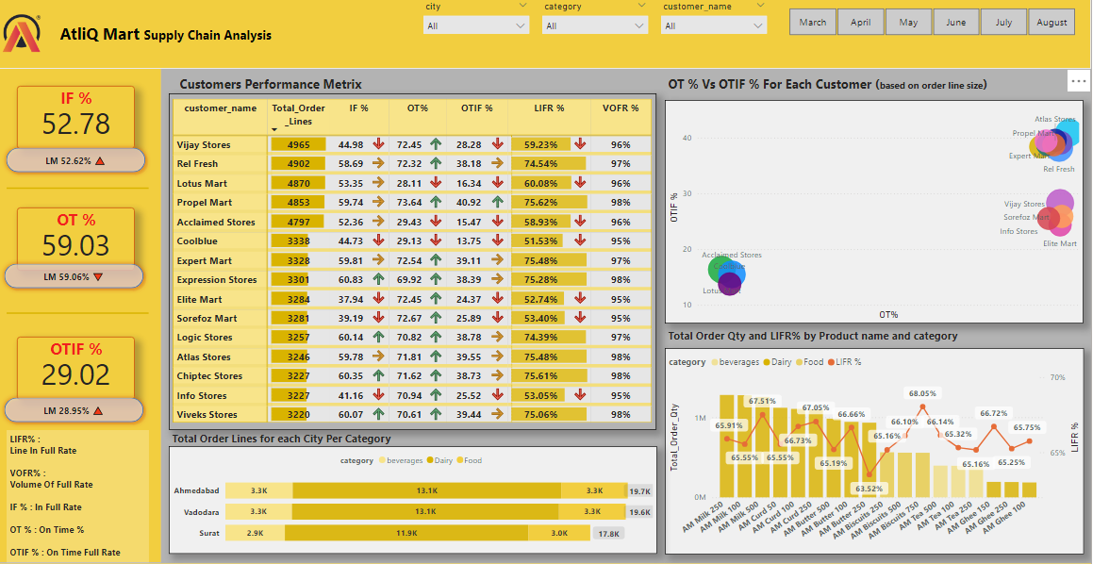
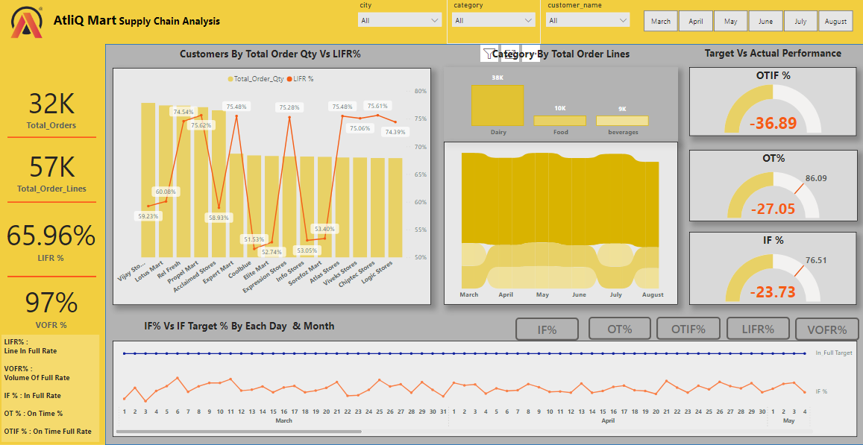
Dashboard

Slide 8
Insights
52.78 %
IF %
59.03 %
OT %
29.02 %
OTIF %

Slide 9
The IF % is almost half and 23.73 % below the target
52.78 %
IF %
59.03 %
OT %
29.02 %
OTIF %

Slide 10
The OT % is 27.05 % below the target
59.03 %
OT %
52.78 %
IF %
29.02 %
OTIF %

Slide 11
The OTIF % is 36.89 % away from the target
29.02 %
OTIF %
52.78 %
IF %
59.03 %
OT %

Slide 12
Recommendations
Increase stock levels for high demand dairy items to prevent stockouts.
Review historical sales data and seasonal trends for dairy products. Improving demand forecasting will help ensure sufficient stock levels to meet customer needs.
Adjust inventory planning to ensure higher fill rates for items frequently ordered by customers who are in risk.

Slide 13
Thanks for showing your interest till the end !!!
Feel free to give your valuable feedback

